Slide 1


Huawei LiteOS
The Open Source Operating System for IoT

Slide 2








Build a Better Connected World with Developers
Lab as a Service
Social
The LEADS concept is redefining Developer experience (DX)
LEADS
Dedicated
End-to-End
Agile
US
$1Billion
in 5 YEARS
To develop an open enablement platform, improving developer experience
Dedicate
To dedvelop an open enablement platform, improving developer experience

Slide 3




































Huawei LiteOS Enable Things More Intelligent
Huawei LiteOS
[ Better Sensing ]
Small Kernel
Lower latency
Lower Consumption
[KB kernel ]
[mW power ]
Lightweight
Smart
[ Better Connecting ]
[mS response]
Open API
Multi-protocols supported
Mesh network
Security
[ Simple Developing ]
Connectivity Sensor hub Service Engine
High-level lauguage for development
Re-Active programming model
Kernel
Lightweight Kernel + N Frameworks

Slide 4



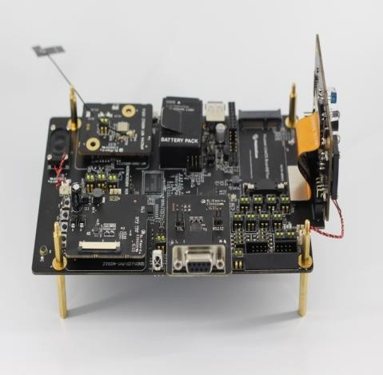







Lighter, Lower Power, Faster Response
[ Start-up speed ： 1 / 8 ]
400ms
Smart Camera
Cold start to the preview:
[ Power： 2 / 3 ]
30m 60m 90m 120
m
1080p recording scene, 1000mAh battery capacity
Huawei LiteOS + HiSilicon

Slide 5
























Lower Latency, Higher Precision
SensorHub Framework Makes Sensors Smarter
Facial recognition
Action recognition
Facial Action recognition recognition
App
App
App
App
App
Fusion Algorithm
Algorithms
SensorHub
Data collection algorithm
↓50% delay
2X+ accuracy
collection algorithm -> fusion algorithm
Sensor
Single-sensor processing
Multi-sensor synergy

Slide 6









































Better Connecting, Multi-Protocols Supported
Home App
Metering App
Manufacturing App
Wearable App
Self healing network
Home Gateway
Mesh Large-scale networking
Multi Protocols Connectivity
BT, WiFi…
NB-IoT…
Multi Devices communication
802.15.4…
Multi-processor support system architecture
Industrial Gateway
Home Profile
Manufacturing Profile
Wearable Profile

Slide 7




An App-framework for IoT, delivers
performance and low power like C
Frame per sec CPU usage (%)
C version
VS
Frame per sec CPU usage (%)
MapleJS version

Slide 8






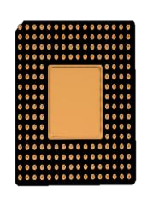




















Huawei LiteOS, Reduce Metering Cost
+
+
Transmission
MCU
Boudica
Huawei LiteOS
2 Chips
1 Chips + Huawei LiteOS
Metering
Huawei LiteOS instead of MCU, reduce cost
Low power consumption, about 10 years

Slide 9

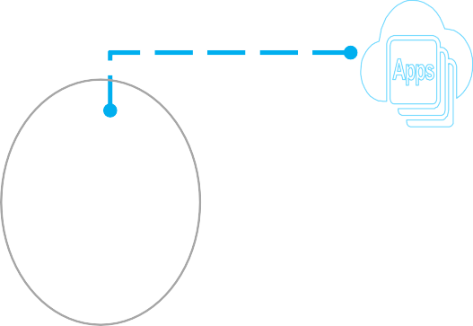




Huawei LiteOS, Saving Energy For Smart Lighting
Operation cost
50%
20%
Energy Consumption
Lighting Management
Huawei LiteOS Mesh Network
Agile Router
Ad hoc network delay < 3s
Network Healing < 20S，1/3 level
1000+ Nodes

Slide 10















Huawei LiteOS Community, Helping
Partners Innovating
Open Source, Commercialized directly
Partners
Community
Support
Development
Open Source for Kernel
Open SDK
Hardware Developing Board
Technical Support
Test, Authentication
Remote Lab
Open Source/API
Support
IDE
Authentication

Slide 11
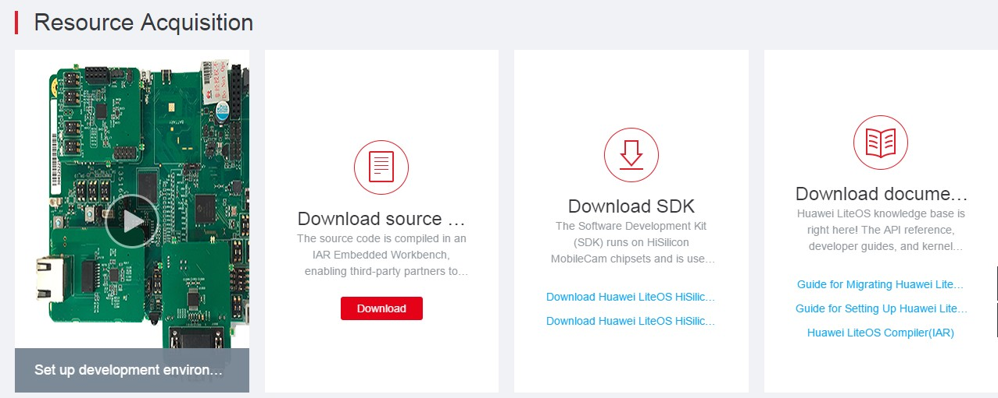
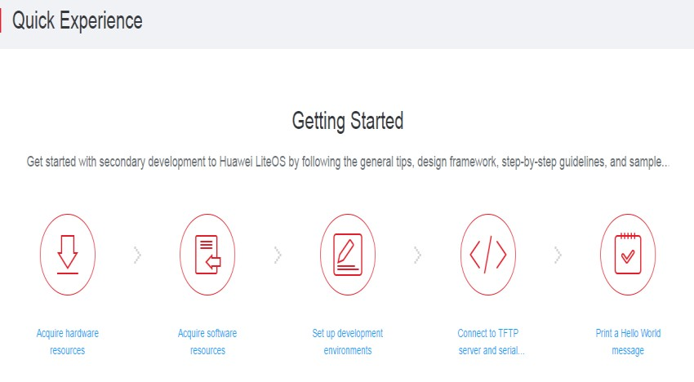
How to get Huawei LiteOS ?
Huawei LiteOS developer community http://developer.huawei.com/ict/en/site-iot/product/liteos
LiteOS Kernel source code and SDKs
Developer Guide：video and technical documents
Evaluation boards introduction

Slide 12
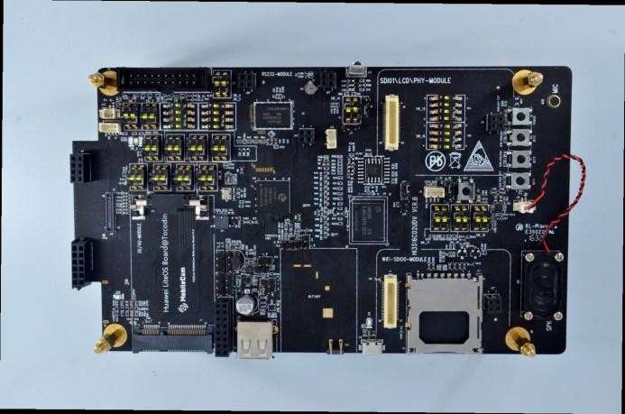
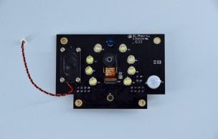
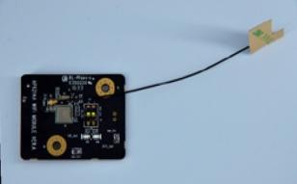
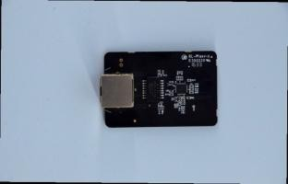

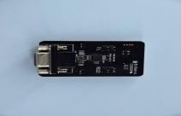
Huawei LiteOS MobileCam board introduction
Sensor Board
WIFI Board
Mainboard
Ethernet Board
LCD Board
UART Board

Slide 13

Contact us
http://developer.huawei.com/ict/cn/events/site-iot-workshop2016-liteos
Any questions or suggestions, please fell freely to contact us:
From Huawei LiteOS development community “Development Queries”
Or sent email to “liteos@huawei.com”

Slide 14
Q & A

Slide 15
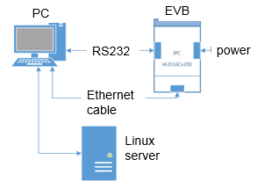
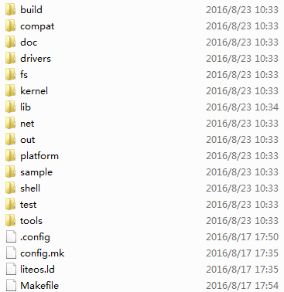
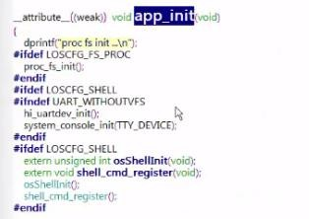
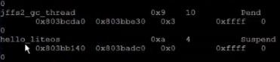
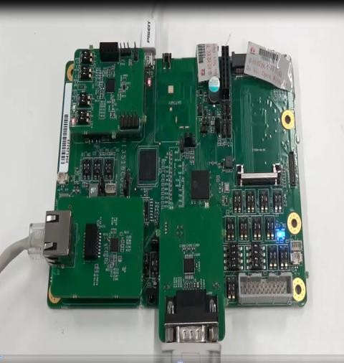
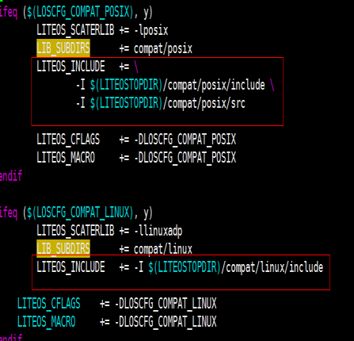
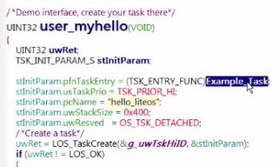
Create a “hello word” task with
MobileCam board
Set up hardware environments
Download LiteOS code from community
Config compiler like arm- huaweiliteos-linux-gcc on Linux server
Set up software environments
Find“app_Init,” and begin your journey with LiteOS
Create a new task, compile the project and porting the Bin file to the board.
Realize your idea with LiteOS
Run the board and you can find the “hello word” task is created.

Slide 16
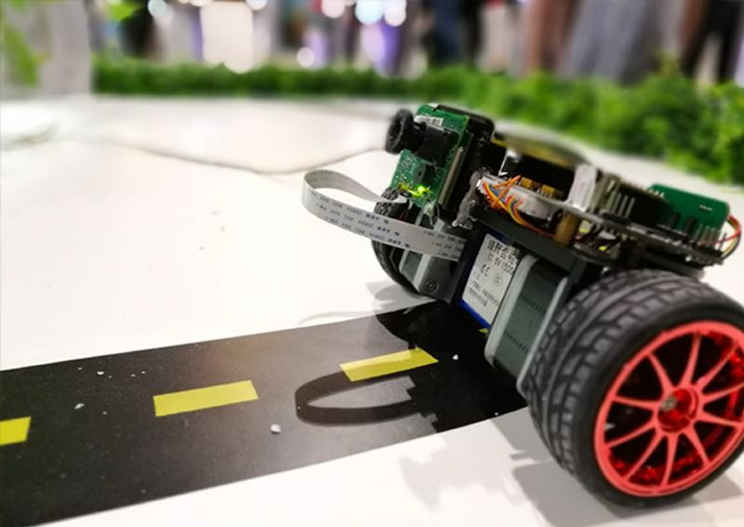
LiteOS Demo: Balanced car for video
surveillance
With LiteOS and it’s connection
SDKs, we can see:
Seamless connecting(Zero- configuration) to gateway and controller(phone) via WIFI.
Fast response to the control command.
Fast development(<2 weeks, 2 people).

Slide 17
















Better Connecting, Multi-Protocols Supported
Metering app
Huawei LiteOS+NB-IoT
Tracking
Lighting
✓ …
IoT Gatway
Wifi，BT， 802.15.4， PLC，
Zigbee…
Simple control
Huawei LiteOS
intelligent
control

